Slide 1
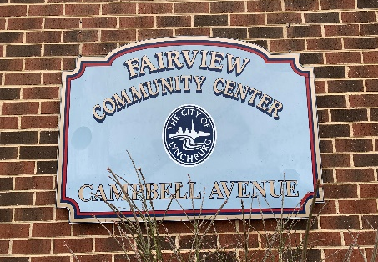
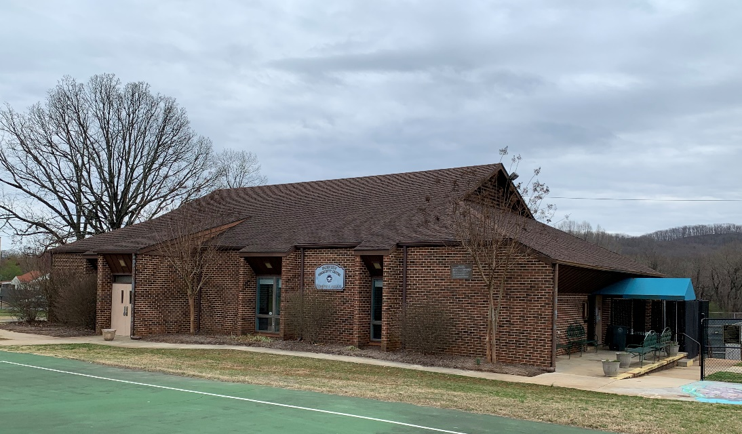
Fairview Heights Neighborhood Center Facility Improvement Project

Slide 2
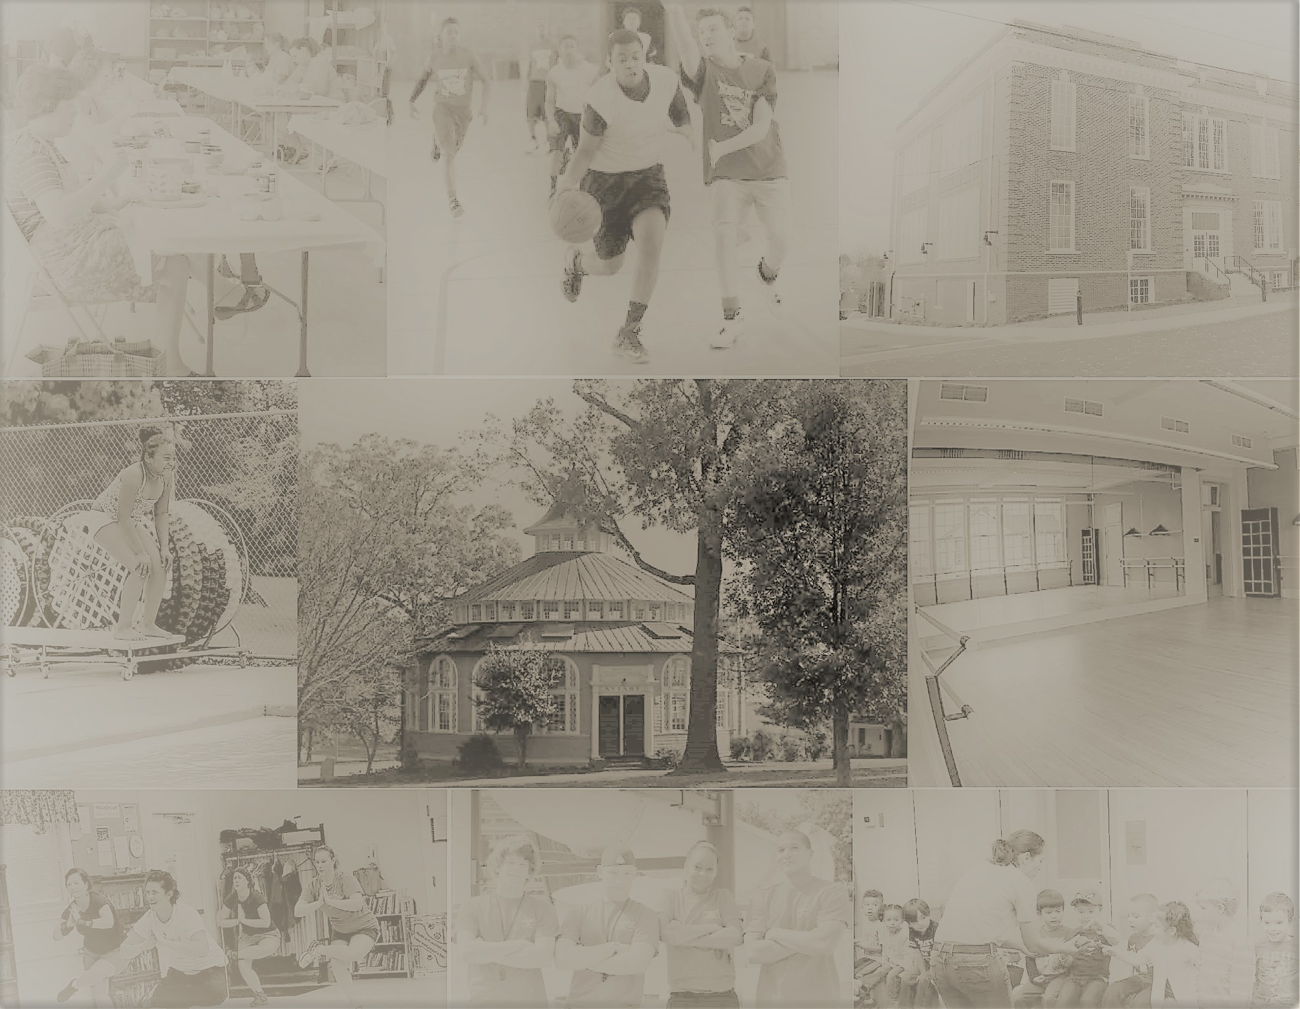
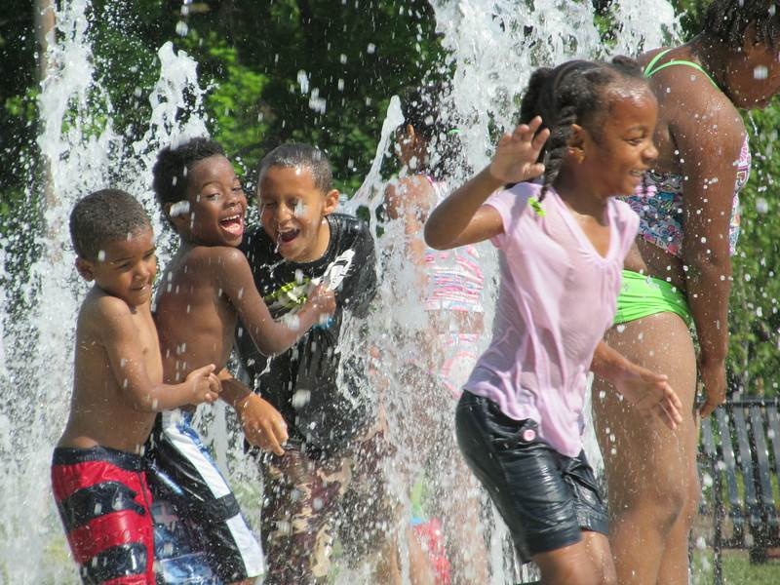
Project Contacts
City of Lynchburg - Parks & Recreation
Charlotte Lester, Neighborhood Centers Manager
Office: (434) 455-5857
Email: charlotte.lester@lynchburgva.gov
Virginia A&E - Consultant
Bill Allen
Office: (434) 316-6001
Email: ballen@virginia-ae.com

Slide 3
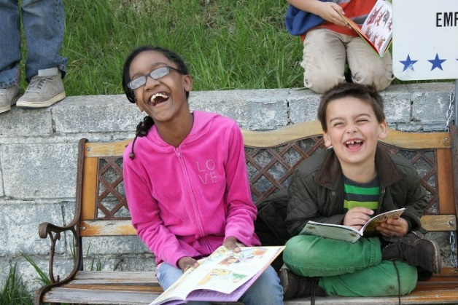
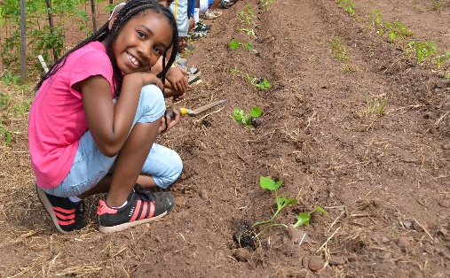
Project Overview
Improvement Project Plans
Project Timeline
Neighborhood Centers – Overview
Fairview Heights Neighborhood
Neighborhood Services
Neighborhood Engagement
Conclusion

Slide 4
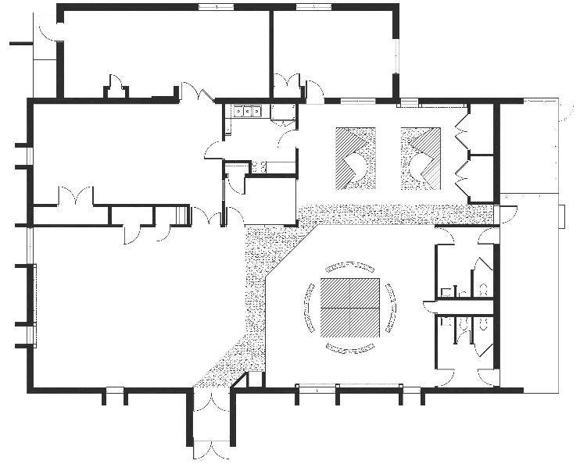
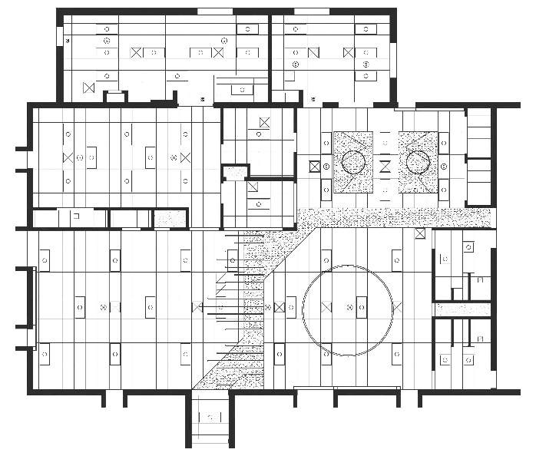
Functional Improvements
Division of multi-purpose room into passive and active use areas.
Cooler at building entrance for storage and distribution of fresh produce to the public.
Integration of freezer into the kitchen for improved operations and management of inventory.
Centralize display areas for announcements, brochures, schedules, acknowledgements, and awards.
Open storage shelving to minimize clutter, improve maintenance of supplies and equipment, and afford participants access to supplies and equipment.

Slide 5
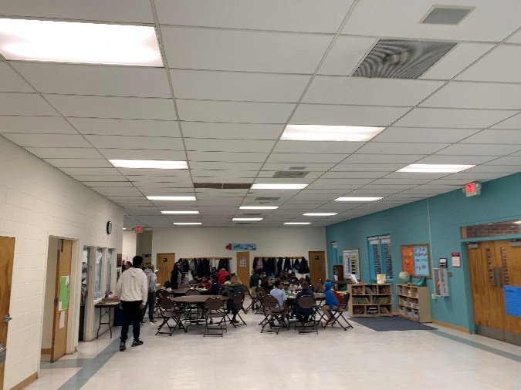
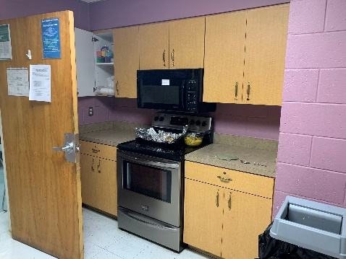
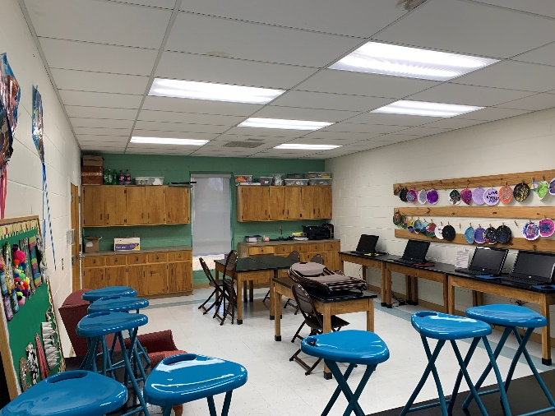
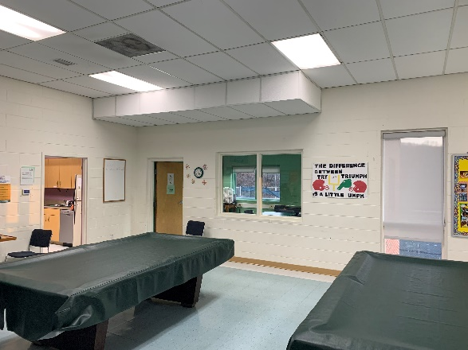
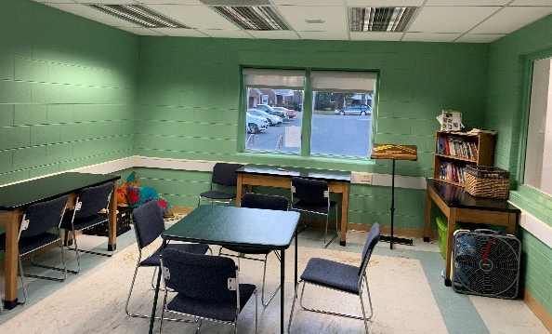
Interior Improvements
Finish Upgrades
Kitchen Renovation

Slide 6
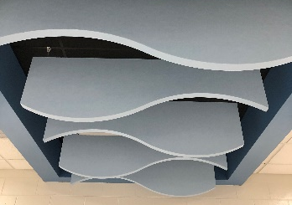
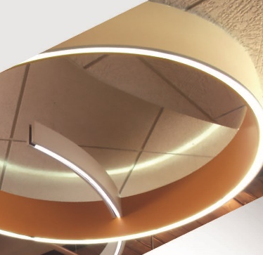
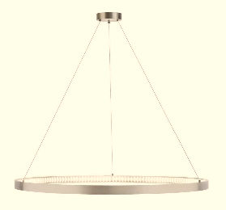
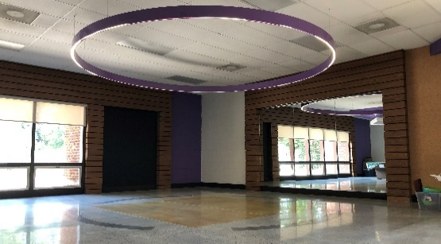
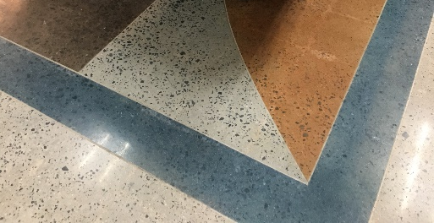
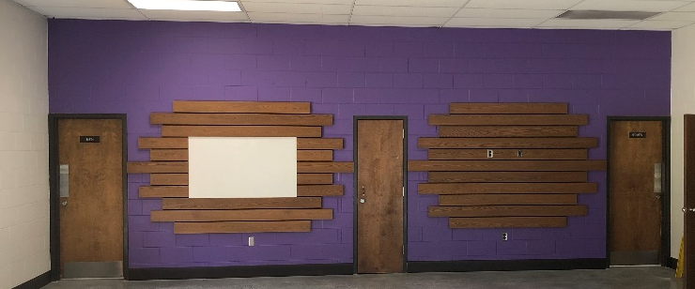
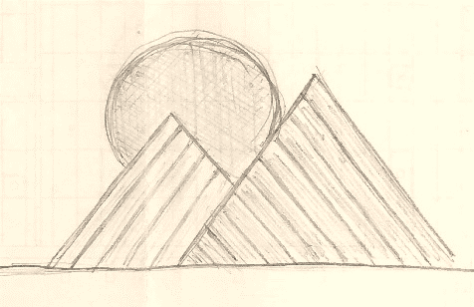
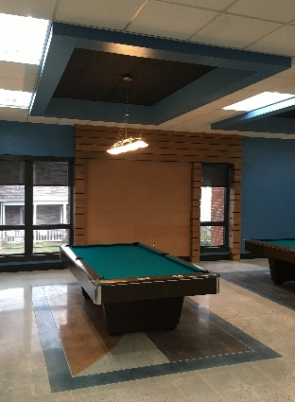
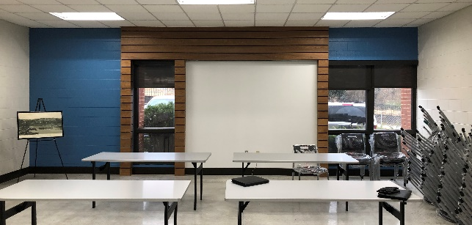
Finish Upgrades
Flooring
Walls
Ceiling Elements
Accent Lighting
Mountain Views

Slide 7
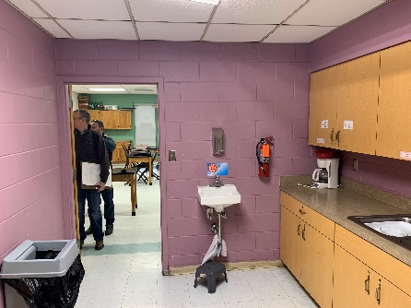
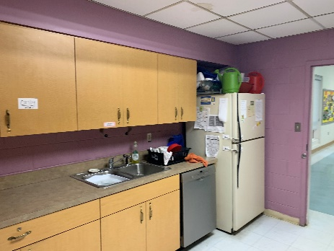
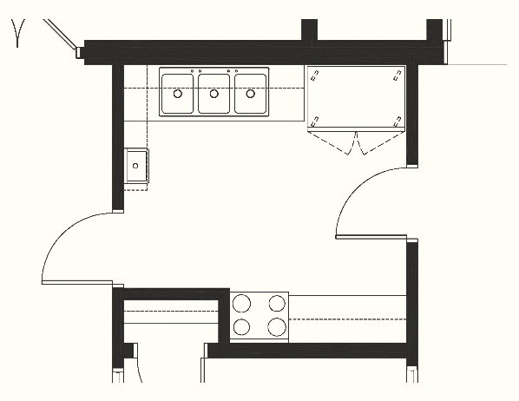
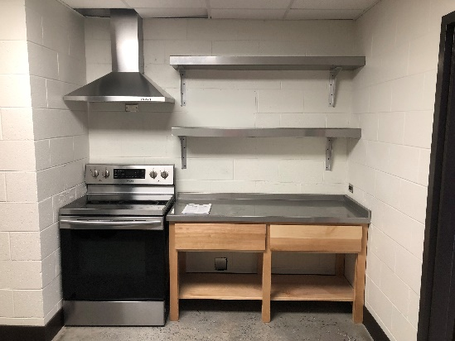
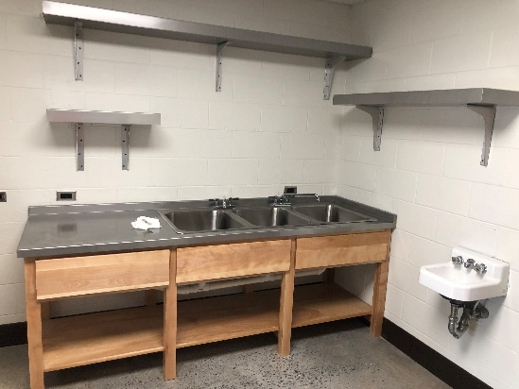
Kitchen Renovation
Flooring
Walls
Ceiling
Casework

Slide 8
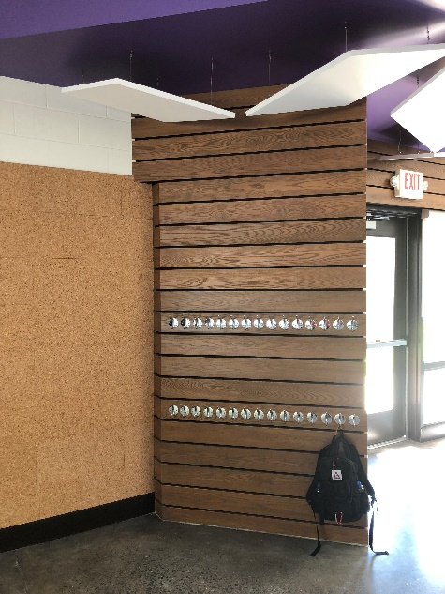
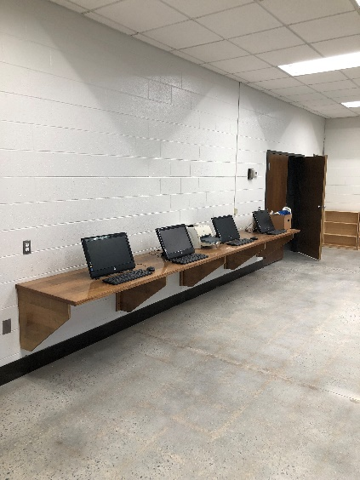
Other Improvements
Open Shelving & Computer Stations
Exterior Door Repairs & Painting
Window Unit Painting
Storage
Display

Slide 9
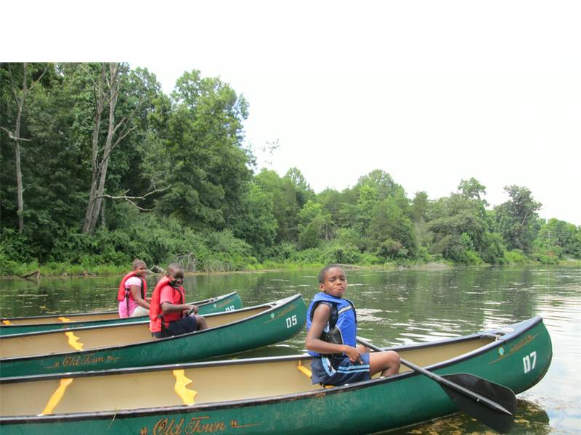
Project Timeline
Finalize Design
March 2020
Bidding & Construction
April to August 2020
Open House
Fall 2020

Slide 10
Neighborhood Centers - Overview
Lynchburg’s neighborhood centers were established between the 1960s and the 1990s in central city neighborhoods.
The primary purpose of neighborhood centers is to provide meaningful services and public spaces to promote health and wellness, conservation, and social equity, for neighborhood residents. Neighborhood services focus on support for education, family, and career development.

Slide 11
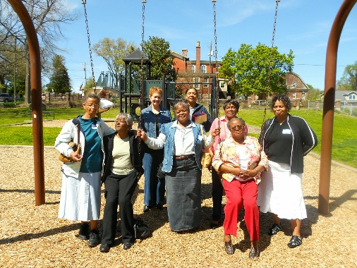
Fairview Heights Neighborhood
Description
Fairview Heights Population
  2,526 Residents
  1047 Households
  Median Age – 40.7
Fairview Heights Neighborhood Center
  Established in 1980
  Current Park Amenities include Tennis Courts, Field Space, Basketball Court, Playground, Teaching Garden, Rain Garden, Picnic Area

Slide 12
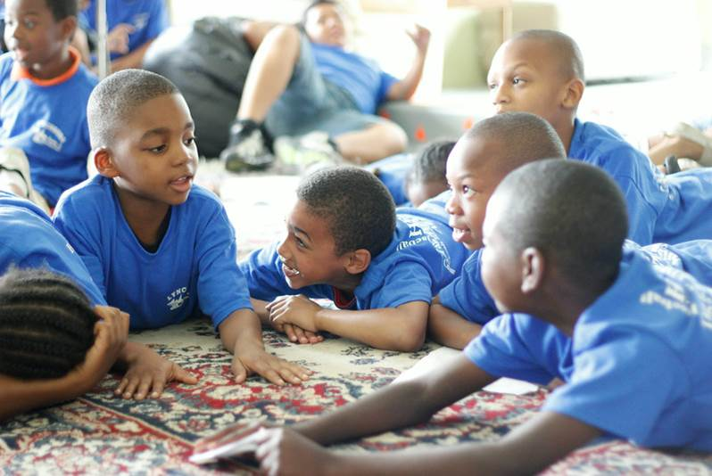
Neighborhood Services
Current Fairview Neighborhood Services
After-School Program
Summer Camps for Youth
Senior Programs
Workshops and Classes
Center Rentals
Neighborhood Meetings
Get-Togethers and Celebrations

Slide 13
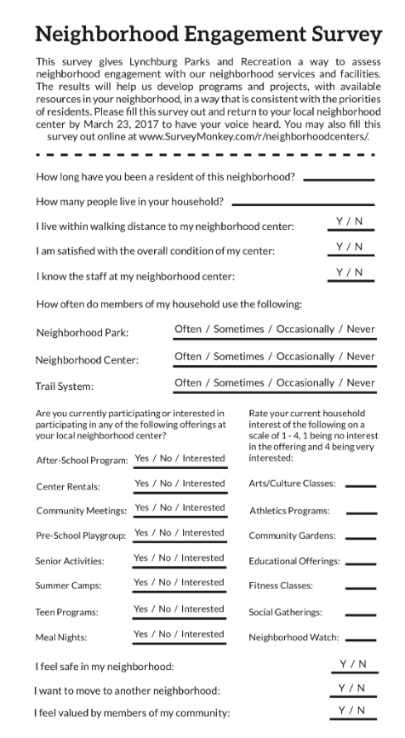
Neighborhood Engagement
Next Step – Staff Continue to Seek Input from Community Stakeholders
Neighborhood Engagement Survey
Focus Groups
Interviews with Stakeholders

Slide 14
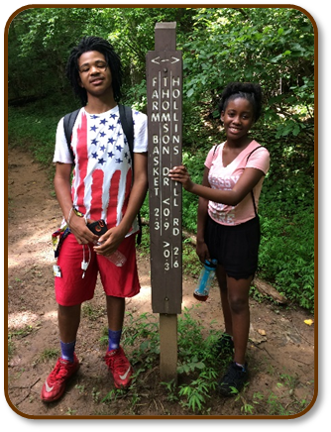
Conclusion and Next Steps
Create a Unique Program Plan for Fairview Neighborhood Center based on:
  Professional Insight / Industry Standards
  Demographic Information
  Neighborhood / Stakeholder Feedback
Complete Facility Improvement Project
Resume Center Programming
Hold Open House for Neighborhood

Slide 15
